Slide 1


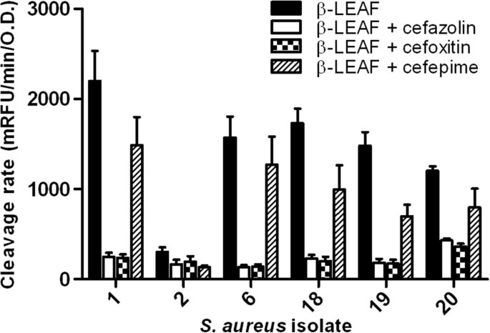
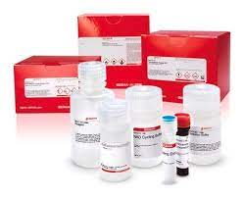
Importance of β-lactamase enzymes in antibiotic resistance
Palak Nagar, Pushkar P. Lele
Email:
plele@tamu.edu
palak_nagar26@tamu.edu
Introduction
Results & Discussion
Conclusions & Future Work
Beta-lactamases are enzymes produced by bacteria, conferring resistance to β-lactam antibiotics like penicillins and cephalosporins.
Critical Role: B-lactamase enzymes are pivotal in antibiotic resistance, undermining the efficacy of β-lactam antibiotics.
They achieve resistance by hydrolyzing the β-lactam ring of these antibiotics. Hydrolysing the ring deactivates the antibiotics, rendering them ineffective.
Monitoring beta-lactamase activity
within bacterial cells is crucial. It
aids in understanding antibiotic
resistance mechanisms.
Helps in developing strategies
to combat drug-resistant infections.
β-LEAF Assay:
Process:
Preparation of Bacterial Cultures : Bacterial strains, including both control strains and clinical isolates, were cultured on Brain Heart Infusion (BHI) agar plates or in BHI broth at 37°C. For some experiments, the bacterial strains were grown in the presence of penicillin disks overnight to induce and enhance beta-lactamase production.
β-LEAF Assay:
Culturing Bacteria: Bacterial colonies were transferred to phosphate-buffered saline (PBS) to create a homogeneous suspension with a known concentration of colony-forming Units
Preparation of Probe Solutions: A stock solution of the β-LEAF probe was prepared in DMSO, and a working solution was prepared by diluting the probe in PBS.
Setting Up Assays: Assays were performed in 96-well plates. Bacterial suspension, antibiotic solution (if testing antibiotic activity), and the β-LEAF probe solution were added to the wells.
Monitoring Fluorescence: Fluorescence was monitored over time using a plate reader. The excitation and emission wavelengths were set to detect the fluorescence emitted by the cleaved β-LEAF probe.
Data Analysis: The rate of fluorescence change over time was determined, normalized by bacterial optical density (O.D.), and used to assess beta-lactamase activity.
Nitrocefin Disk Test:
Moistening Disks: Nitrocefin disks were moistened with distilled water.
Inoculation with Bacterial Colonies: Bacterial colonies grown in the presence of penicillin disks (for induced cultures) were smeared onto the surface of the nitrocefin disks.
Observation: The disks were observed for a color change from yellow to deep orange, indicating beta-lactamase activity.
Interpretation: The color change was interpreted as a positive result for beta-lactamase production
β-LEAF assays can be
used to determine activity
of multiple antibiotics
simultaneously.
Accurate Measurement: Precise measurement of B-lactamase activity is imperative for understanding resistance mechanisms and developing effective countermeasures.
Future Directions:
Develop advanced techniques for rapid and accurate detection of B-lactamase activity.
Explore novel strategies to inhibit or neutralize B-lactamases.
Implement stringent surveillance measures to monitor the
prevalence and spread of B-lactamase-producing bacteria.
Collaborative Efforts: Continued collaboration among researchers, clinicians, and policymakers is essential to combat antibiotic resistance effectively.
Public Health Imperative: Addressing the challenge of B-lactamase-mediated resistance is crucial for safeguarding public health and ensuring the continued efficacy of antibiotic therapies.
Methods
References
Real-time activity assays of β-lactamases in E.coli
1. E. coli cells expressing the β-lactamase enzyme are induced and washed to remove external elements.
2. The washed cell suspension is utilized for UV-Vis spectroscopy measurements without cell lysis.
3. UV-Vis spectroscopy tracks changes in absorption peaks of β-lactam antibiotics inside living bacterial cells, indicating enzymatic activity.
β-LEAF Assay:
1. β-LEAF assay: Measures beta-lactamase activity inside bacterial cells using a fluorescent probe. No cell lysis is required.
2. Nitrocefin Disk Test: Detects beta-lactamase activity directly on agar plates. Color change of the disk indicates enzyme presence.
3. Procedure: Bacterial colonies suspended in PBS, β-LEAF probe added, fluorescence monitored. Nitrocefin disks were moistened, inoculated, and observed for color change.
Phenotypic and hydrolysis-based detection :
1. Acidimetric, iodometric, spectrophotometric, mass spectrometry, lateral flow immunoassay, and fluorescent probe methods detect β-lactamase activity through antibiotic substrate or product detection.
2. Gene tests like PCR, LAMP, and DNA sequencing directly detect β-lactamase genes in bacterial cells.
3. These methods offer both physical and biological detection approaches for β-lactamase activity and gene presence.
NFAT-β-lactamase blue/green assay:
1. High sensitivity, real-time detection, and high-throughput screening compatibility.
2. Enables study of intracellular protein activities like PMT in intact mammalian cells.
3. Useful for screening mutant proteins, vaccine characterization, and clinical diagnosis.
1. Ying, Ge., Ya-Jun, Zhou., Ke-Wu, Yang., Yi-Lin, Zhang., Yang, Xiang., Yue-Juan, Zhang. (2017). Real-time activity assays of β-lactamases in living bacterial cells: application to the inhibition of antibiotic-resistant E. coli strains.. Molecular BioSystems, 13(11):2323-2327. doi: https://doi.org/10.1039/C7MB00487G
2. Khan, S., Sallum, U. W., Zheng, X., Nau, G. J., & Hasan, T. (2014). Rapid optical determination of β-lactamase and antibiotic activity. BMC Microbiology, 14, 84. https://doi.org/10.1186/1471-2180-14-84 3. .https://www.sigmaaldrich.com/US/en/product/sigma/mak221?icid=sharepdp-clipboard-copy-productdetailpage
Commercial kit to inhibit the activity of Beta-lactamase by Sigma
Retailing for $1020
High throughput
Sufficient for 100 Colorimetric tests
Acknowledgements
I would like to thank our advisor, Dr. Pushkar P. Lele, and my group members for their support of this project additionally online sources like Science Direct for helping me with papers relevant to the topic.
Notes:
INCLUDE IMAGES OF ACTUAL SAMPLES IN METHODS SECTION

